Slide 1
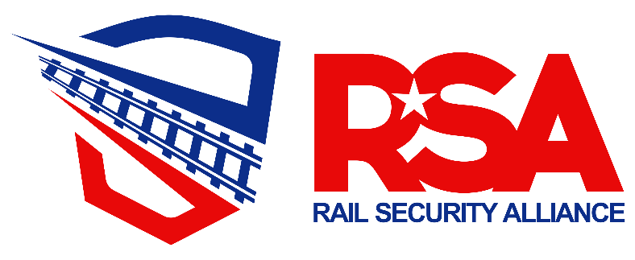
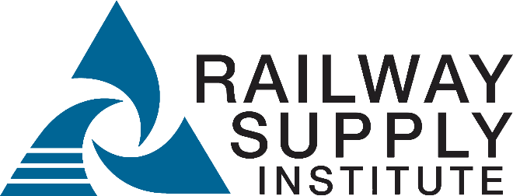
Threats Facing the American Rail Industry: Issues and Solutions
2020

Slide 2
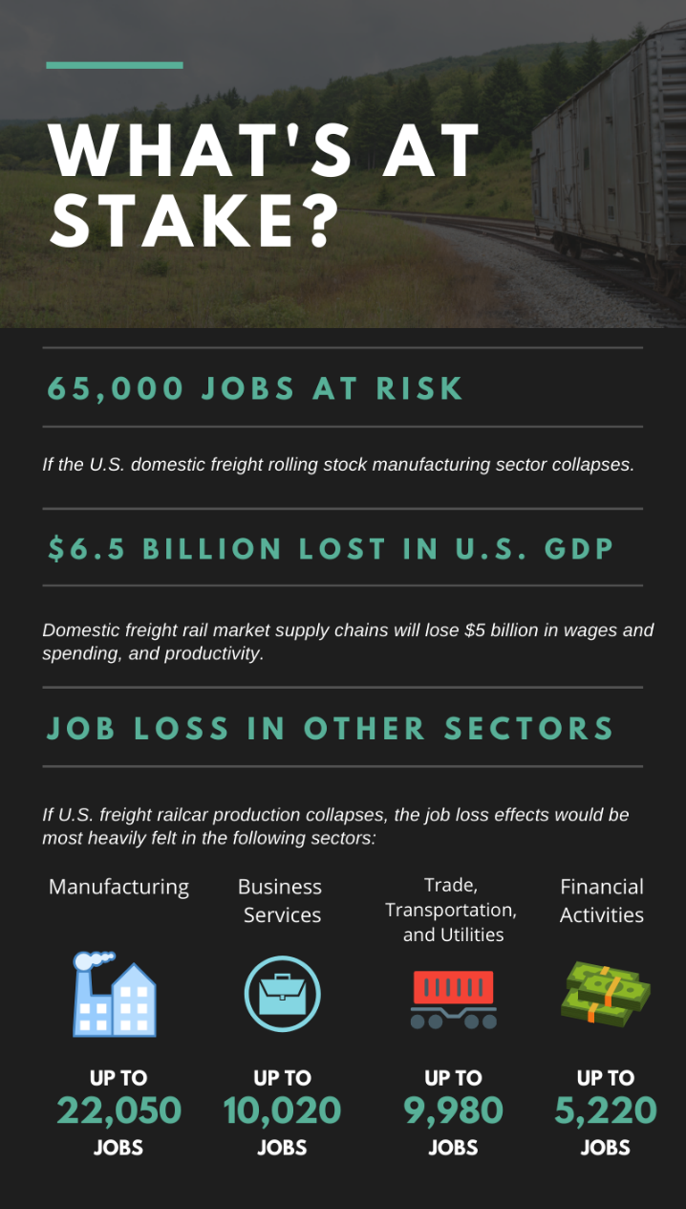
The State of the Rail Industry
The COVID-19 pandemic has greatly impacted the freight rail supply industry. Freight railcar orders and backlog are plummeting due to the effects of the COVID-19 pandemic. Without action by Congress, this decline will result in thousands of job losses like the Great Recession, when industry unemployment reached 18.5%*
*Source: U.S. Bureau of Labor Statistics, Transportation Equipment Manufacturing, July 2009
Freight Railcar Orders & Backlog 2005-2020

Slide 3
The Ongoing Threat from China
Aside from the serious impacts on the industry due to the COVID-19 pandemic, the U.S. remains under serious threat from Chinese rail and steel state-owned enterprises.
CRRC has made aggressive advances into the U.S. by using state-backed financing, below-market pricing, and other anti-competitive tactics to decimate domestic railcar manufacturing with the single end goal of destroying all domestic rolling stock production and producing all railcars in the PRC.
Over the past 5 years, CRRC has won more than $2.6 billion in U.S. transit rail contracts. The CRRC penetrated the Australian market in the same way and within nine years had decimated the Australian domestic rail industry and is now the sole supplier to Australia with all railcars made in China.
CRRC claims they have no intent of entering the freight rail market, yet their actions say otherwise.
Allowing unrestricted and continued CRRC activity during the COVID pandemic into the North American freight rail manufacturing sector threatens American economic and national security interests at the worst possible time – a duel, potentially industry ending threat.

Slide 4
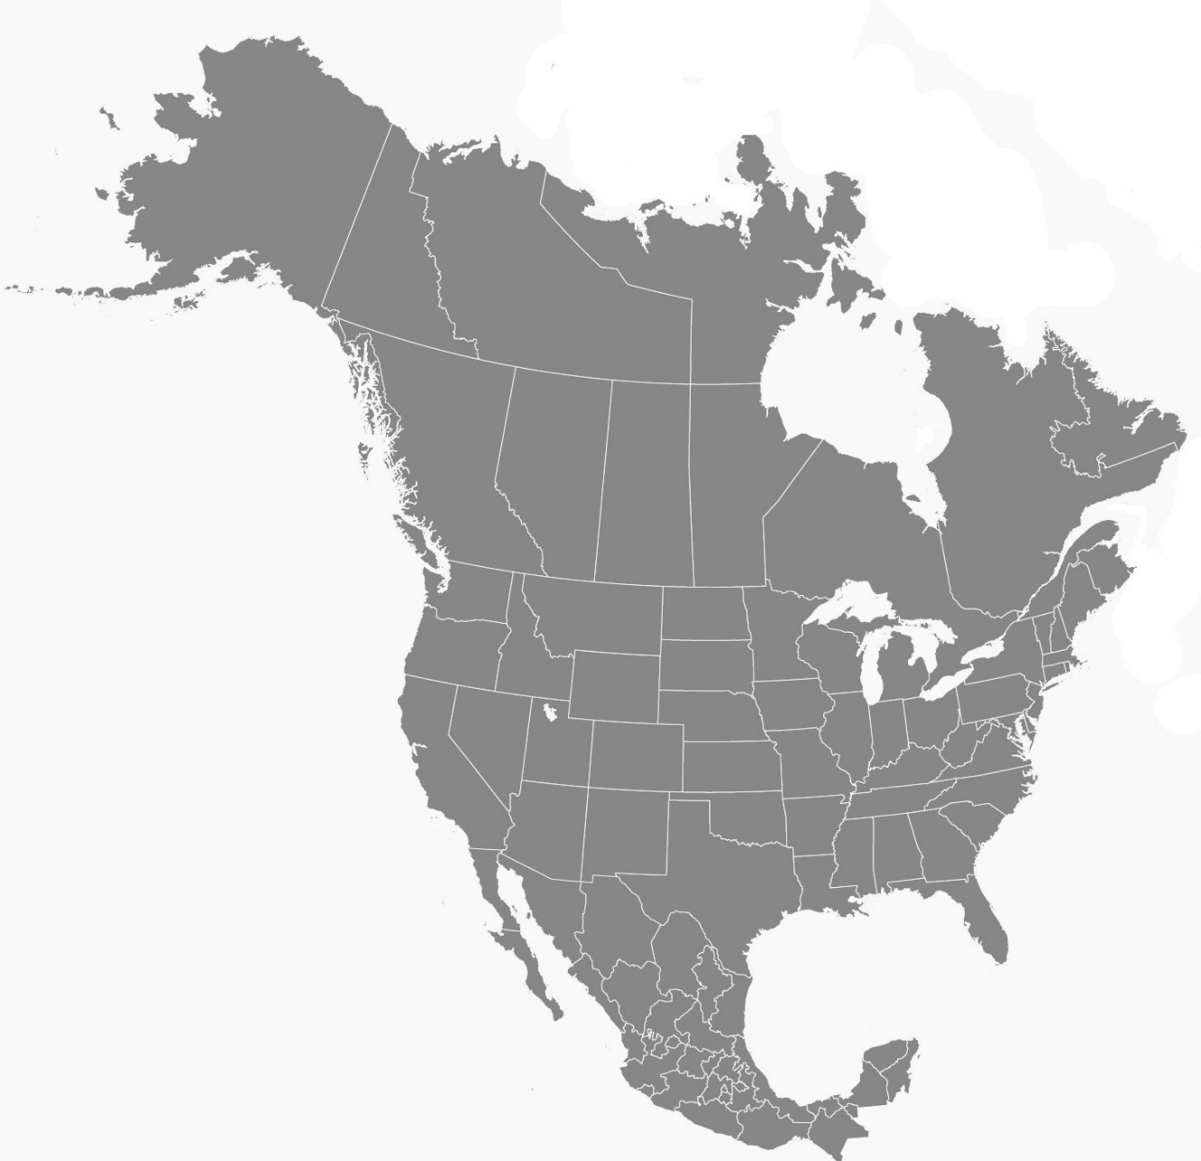
CRRC Advances In the North American Market 2015-2020
ARS Canada Rolling Stock Inc., a joint venture for CRRC to build freight railcars in Moncton, New Brunswick (2017)
CRRC won $1.3B contract from Chicago Transit Authority. CRRC’s second U.S. facility has been built in Chicago (2016)
CRRC awarded $137.5M contract to build bilevel railcars in Philadelphia (2017)
CRRC won a bid in Montreal to supply 44 double-decker coaches (2017)
CRRC built a $95M plant in Springfield to supply the $566M Boston subway contract (2015)
CRRC unsuccessfully bid for a $600 million contract to supply railcars for Atlanta’s MARTA system (2019)
CRRC won a grant award to design New York City’s next generation of subway cars (2018)
The CRRC Springfield facility will supply cars for CRRC’s $178M Los Angeles rail contract (2017)
Passage of TIVSA legislation ensures CRRC cannot bid on WMATA in Washington, D.C. (2019)
CRRC won a contract for 26 light rail vehicles with Monterrey Metro Bureau (2019)
Miami-Dade prohibited Chinese transit companies from bidding on new monorail project (2019)
CRRC previously owned 50% of a now-defunct rail car manufacturer Vertex in Wilmington, NC (closed 2018)

Slide 5
The Freight RAILCAR ACT – A Commonsense Recovery Solution
H.R 8082, introduced by Reps. Schneider, LaHood, Blumenauer, Ferguson, Lipinski & Crawford - The Freight Rail Assistance & Investment to Launch Coronavirus-era Activity & Recovery Act (Freight RAILCAR Act)
This bill will: provide investment tax credits to encourage the replacement or modernization of North America’s freight railcar fleet with higher capacity, more fuel-efficient vehicles, and help stabilize jobs in the railcar manufacturing industry in response to the Coronavirus (COVID-19) pandemic.
Provides a time-limited 50% tax credit for new railcars or modification of existing railcars to help offset the costs associated with replacing or refurbishing cars that improve fuel efficiency or capacity.
This credit will expire on December 31, 2024.
Provides a separate tax credit available for the scrapping of a railcar based on the depreciated value of that specific asset.
This credit also expires on December 31, 2024.
Provides a time-limited 50% tax credit for capital expenditures on equipment or technology enhancements in railcar-related manufacturing or repair shops if that equipment improves the efficacy, quality, or safety of railcar or railcar component manufacturing.
This credit will expire on December 31, 2023.

Slide 6
Freight Railcar Modernization Promotes Environmental Efficiency while Upgrading Critical Infrastructure
Modern Freight Railcars Create an Efficient Environment
New high strength and lightweight materials, innovative designs and advanced technologies equals lighter, more energy-efficient freight railcars. These modernized freight railcars carry greater loads and use less fuel, therefore reducing greenhouse gases. Incentivizing private investment in new freight railcars that utilize these modern designs with increased capacity results in reduced shipping costs and an increase in long-haul freight moved by rail.
Modernizing a Freight Railcar Saves Diesel Fuel and CO₂ Emissions Annually:
Hopper Cars– 30.5 million gallons of fuel, .342 million tons of CO₂
Double Stack “Intermodal” Cars– 15 million gallons of fuel, .168 million tons of CO₂
Autorack Railcars—59.2 million gallons of fuel, .663 million tons of CO₂
Producing a ton of steel today in North America requires less than half the energy that was needed to produce a ton of steel 40 years ago, resulting in a 50% reduction in greenhouse gas (GHG) emissions
Steel from scrapped railcars can be recycled into new steel

Slide 7
Why the Freight RAILCAR Act Should Be Included In a Future Infrastructure Recovery Package
There are currently 1.7 million freight cars in the U.S. fleet, many are older than 30 years. This legislation would enhance and modernize the fleet. Due to the COVID-19 pandemic, it is imperative this critical infrastructure industry is preserved.
State-owned railcar builders, including CRRC should it opt to enter the US freight car market, are ineligible to participate in this tax credit program; the new cars must be built or refurbished in a North American facility that is not state-owned.
This bill gives incentives for shippers and leasing companies that buy freight rail cars to speed up capital expenditures on freight rail cars. The freight rail industry currently does not have any investment tax credits.
HR 8082 enhances tank car modernization schedules under FAST Act, in the end the bill will help modernize the freight rail fleet for a post-COVID recovery.
Including the Freight RAILCAR Act in a
future infrastructure recovery package will:
Assist in protecting 65,000 American manufacturing jobs
Promote environmentally efficient railcars and upgrade the domestic rail fleet using recycled steel
Help the rail supply industry survive the economic impact of COVID-19 pandemic

